Slide 1

David Hoff
Program Director
Institute for Community Inclusion
University of Massachusetts, Boston www.communityinclusion.org
Voice: 617-287-4308
E-mail: david.hoff@umb.edu
Municipal Government:
Overview of Accessibility, ADA, and Program/Service Access

Slide 2

Agenda
Basics of disability and impact on municipal services
Legal Requirements - ADA Title II etc.
Effective handling of accommodation/modification requests
Beyond compliance: Best practices in creating a welcoming environment for people with disabilities
Disability etiquette and language

Slide 3

Discussion
When we say the term “disability”, what types of conditions come to mind?

Slide 4

Examples of Disabilities
paralysis
blindness or visual impairment
deafness or hard of hearing
intellectual disabilities
learning disabilities
psychiatric disabilities and mental health conditions
chemical sensitivity
epilepsy
head injuries
cerebral palsy
chronic health or physical issue
autism
HIV/AIDS

Slide 5

12% of people in Massachusetts identify as having a disability, per US census.
Self-awareness and self-perception of disability varies.
Many disabilities are non-apparent or “hidden”.
Impact of disability on person’s life varies.

Slide 6

What have been your experiences in providing municipal services to people with disabilities?

Slide 7

Meeting the Needs of Residents with Disabilities:
Core Principles
Comply with legal requirements.
Ensure residents with disabilities have access to same services as all other residents.
Promote universal access.
Create a truly welcoming environment for all.

Slide 8
Access to same services, programs, and services does not necessarily mean accessing them in the same way.

Slide 9

Legal Requirements

Slide 10

Basis For All
Disability
Laws and Policies

Slide 11

Disability
as defined by the ADA
A physical or mental condition that substantially limits one or more major life activities
Being regarded as having a disability, even when no limitations exist

Slide 12


Is substance abuse a disability under the Americans with Disabilities Act?
Someone who is actively using illegal drugs is not considered to have a disability.
A person who is an alcoholic who is not in recovery may be considered disabled.
A person who is in recovery from substance abuse may be considered disabled.
Disability cannot be used as an excuse for being under the influence of drugs or alcohol, when it is prohibited, or causes a person to engage in misconduct.
This Photo by Unknown Author is licensed under CC BY

Slide 13
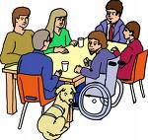
Americans with Disabilities Act (ADA)
Title I: EMPLOYMENT
Title II: PUBLIC SERVICES
Title III: PUBLIC ACCOMMODATION (private businesses)
Title IV: TELECOMMUNICATIONS
Title V: MISCELLANEOUS PROVISIONS

Slide 14


ADA Title II: Public Services

Slide 15

ADA: TITLE II
PUBLIC SERVICES
Discrimination by state and local government services prohibited.
Services, programs, activities when viewed in their entirety:
readily accessible and usable by individuals with disabilities.
Do not need to remove physical barriers, as long as programs are accessible to individuals who are unable to use an inaccessible existing facility.
Must provide programs and services in integrated setting, unless separate setting is necessary to ensure equal opportunity.
No unnecessary eligibility standards or rules that deny individuals with disabilities equal opportunity to enjoy services.

Slide 16
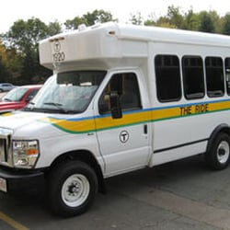
ADA: TITLE II
PUBLIC SERVICES
Reasonable modifications in policies, practices, and procedures are required unless undue burden or fundamental alteration in program, service or activity, would result.
Must furnish auxiliary aids and services to ensure equally effective communication, unless undue burden or fundamental alteration.
No special charges.
Public transportation systems must be accessible to
people with disabilities. Transit authorities must provide supplementary paratransit services or other special
transportation services for individuals with disabilities
who cannot use fixed-route bus services.

Slide 17
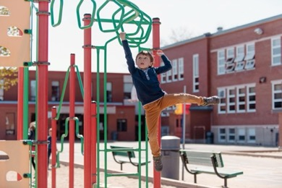






What does ADA Title II apply to?
All municipal buildings, programs, and services
  City government operations
  Schools
  Libraries
  Recreation facilities
  Parks
  City owned/operated facilities
  Public safety

Slide 18

Contracted Services
If the municipality is contracting for services with a private entity, ADA Title II applies to those contracted services

Slide 19
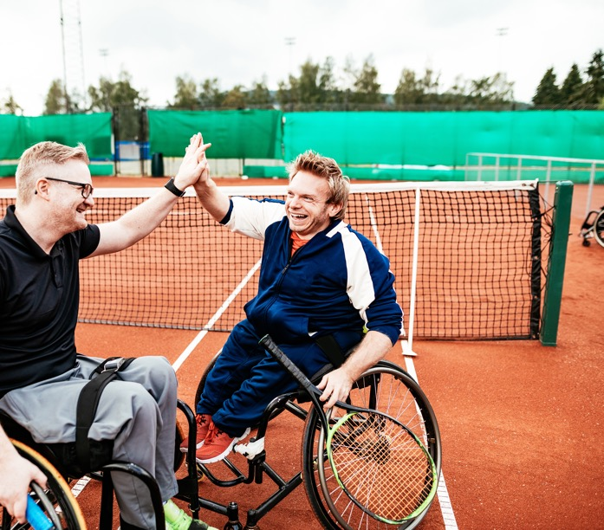
Separate Services
Services specifically for people with disabilities are permitted
  Example: recreation program for people with disabilities
If a similar program for people with disabilities and one for the general public are both offered, people with disabilities can choose which program to participate in, if they meet the eligibility requirements

Slide 20

Asking About Disability
Title I – Employment: Disability inquiries only permitted if “job-related and consistent with business necessity”
Title II - Public Services:
Only necessary inquiries are permitted

Slide 21

More About Disability Inquiries Under Title II
Municipality should not make unnecessary inquiries.
Municipality determines what a necessary inquiry is.
Examples of why disability inquiries may be necessary in providing municipal services:
  To provide modifications/accommodations and assistance
  Determining qualification for programs specifically for people with disabilities
  Demographic information
Inquiries that have the effect of discriminating are not permitted.

Slide 22
Guidelines for disability inquiries
Explain why inquiry is being made, how information will be used, and that it is confidential.
Be clear that information is voluntary.
Maintain confidentiality.
Be consistent regarding inquiries in terms of who is asked and how inquiries are made.

Slide 23

Emergency Preparedness
Incorporate the needs of people with disabilities within emergency preparedness
  Notifications
  Access to information
  Evacuation procedures
  Emergency transportation
  Accessible emergency shelters
  Back-up power, refrigeration
  Recovery

Slide 24


Website and app accessibility
Municipal websites and apps must be accessible to people with disabilities.
Per April 2024 federal rule, all municipal websites and apps must comply with Web Content Accessibility Guidelines (WCAG) Version 2.1, Level AA.
Compliance dates:
  Population up to 49,999 – April 26, 2027
  Population 50,000 or more – April 26, 2026

Slide 25
Title II Administrative Requirements
Self-Evaluation
ADA Notice
Information on accessible services, activities, and facilities
Appoint an ADA Coordinator
Establish a grievance procedure
Develop a transition plan
Municipalities with 50 or More Employees

Slide 26

Reasonable
Modification/Accommodation
Requests

Slide 27
Examples of Reasonable Accommodations/Modifications
Providing materials in an alternate format
Verbally collecting information instead of collecting it in writing
Providing a service or holding a meeting in an accessible space
Holding a 1:1 meeting over the phone/online rather than in-person
Meeting with an individual 1:1 rather than a large group
Providing staff to assist an individual at an event
Allowing attending of meetings online rather than
in-person
Provision of sign language interpreters

Slide 28
Best practices:
Requests for Modifications/Accommodations
Prominent and clear notice of availability of accommodations/modifications and how to request them.
  All public spaces - Service desks, meeting rooms, etc.
  Meeting notices/agendas
  Event registrations
  Website
  Event materials
  Social media
  Clear policies and procedures on how requests should be handled.
      Individualized evaluation process.
      Decision not to provide must be made at Department Head level or higher.
      Full array of resources available must be considered.
      If undue burden, alternatives provided.
  Clear deadlines on making requests.
  Staff trained on how to solicit and respond to requests.

Slide 29
Handling Modification/Accommodation Requests
Explain to individual the process for making request and review.
Engage in dialogue with individual as needed:
    What is the purpose of the modification/accommodation? What will it allow the individual to accomplish? What is their goal?
    What are potential options for modification/accommodations?
    What have they found works best for them in similar situations?
Remember: there may be multiple methods for meeting a need.
    Example: Person may request ASL, when captioning or texting can meet need for equally effective communication.
Provide response verbally and in writing.
Communicate and work with individual on details of modification/accommodation.
Reach out to experts as needed.

Slide 30

Documentation of Disability
Documentation of disability is not required.
Should only be requested if absolutely necessary.
If disability is not obvious, municipality may ask individual for documentation from a health care provider, that specifies:
  The person has a disability
  The limitations caused by the disability
  How the requested accommodation addresses those limitations

Slide 31

Disability Accessibility Scenarios

Slide 32
Best Practices

Slide 33
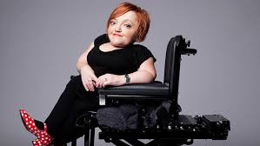
“My disability exists not because I use a wheelchair, but because the broader environment isn't accessible.”
Stella Young

Slide 34

Universal Design
Create environments that are usable by as many people as possible regardless of their age, size, ability, or disability

Slide 35



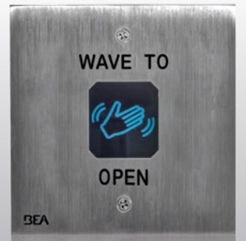

Slide 36
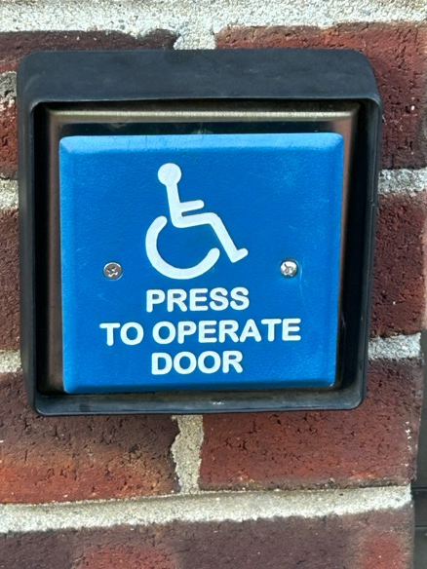
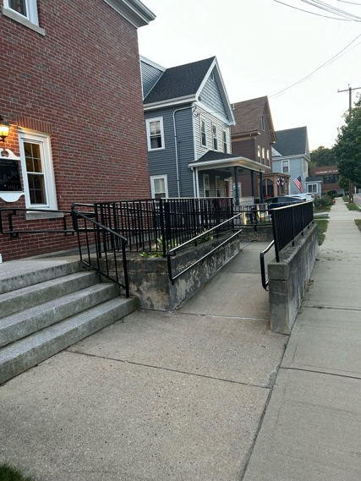
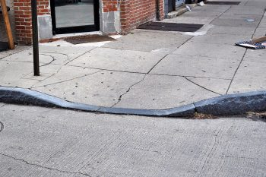
Accessibility benefits everyone…
This Photo by Unknown Author is licensed under CC BY

Slide 37

Basics of universal communication
Multiple methods for making information available:
verbally, in writing, pictures, graphics, video
  Simple and clear words
  Avoid use of jargon and acronymns
  Captioning: videos, online meetings
Allow for multiple ways of gathering information:
online, in-person, electronically, use of paper.
Allow for multiple ways of expressing information:
verbally, in writing, electronically.
Use microphones in public meetings.
Sign language interpreters, CART (Communication Access Realtime Translation) for large public events.

Slide 38

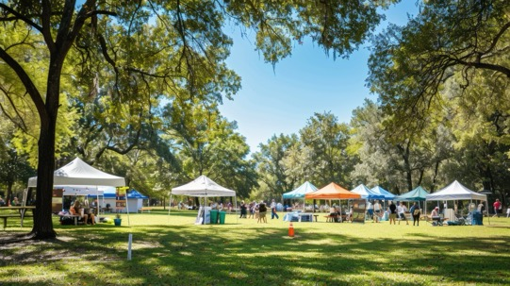
Public Events
Method for requesting accommodations/modifications clearly advertised.
Have point person for accessibility, and review venue and/or online platform prior to event.
At beginning of event:
  Announce commitment to having an event that is fully accessible.
  Review any accessible features of event and contact person for any accessibility needs during event.
  Review emergency evacuation procedures.

Slide 39
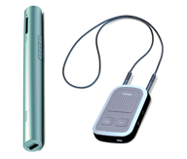


Assistive Devices
List of assistive devices prominently available.
Assistive devices in good repair and easy to access.
Staff trained on use of devices.
Examples:
  Hearing loop – assistive listening device
  Magnifying device
  Large print materials
  Braille materials
  Computers available for public use: screen reading technology,
  voice recognition, screen enlargement, specialized computer mouse

Slide 40

Discussion:
Applying Universal Design in Municipal Services

Slide 41

Disability Etiquette and Guidelines

Slide 42
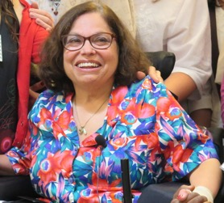
“Disability only becomes a tragedy when society fails to provide the things we need to lead our lives — job opportunities or barrier-free buildings, for example.
It is not a tragedy to me that I'm living in a wheelchair."
Judy Heumann

Slide 43

Basic Etiquette
Avoid stereotypes
Don’t presume someone does or does not have a disability
Don’t presume what someone needs or doesn’t need
Assume capability
Ask before helping
Don’t hesitate to ask
  “Is there any type of assistance that would be helpful?”
  Let me know if you need anything.
Respect and connect with the person as an individual
Respect people’s privacy
Don’t be patronizing
Treat adults like adults
Miss Manners

Slide 44
Overview of Different Disabilities

Slide 45

Issues
Be patient, encouraging and non-judgmental.
Repeat information as necessary.
Do not rush the person.
Maintain a calm tone.
Do not assume that someone with mental health issues can’t make decisions for themselves.
Do not be confrontational.
If the area is noisy and chaotic, particularly if they are getting confused or agitated, ask if they would like go to a quieter area.
If the person is going on at length, repeating themselves, or going off on tangents, gently cut off the conversation and redirect.
If the person is in crisis, ask how you can help.

Slide 46

People who are neurodiverse
Be direct, literal, and concrete with language.
Explain situations clearly.
Give an overview of what to expect, and length of time it will take.
Listen and don’t interrupt. Be comfortable with pauses as the person processes.
Try to provide advance notice on changes.
Listen to the person’s words. Avoid interpreting their tone or body language.
Give person time to process information.
If the area is noisy and chaotic, ask if they would prefer a quieter space.
Offer multiple methods of communication: verbal and writing.

Slide 47
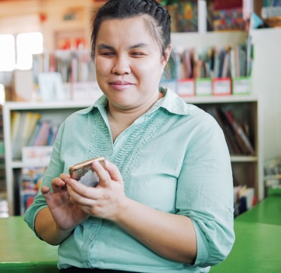
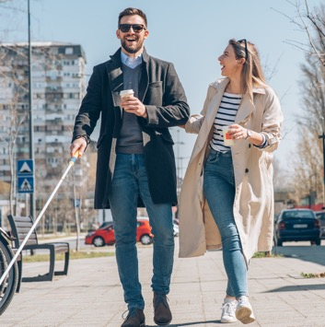

Blind or Visually Impaired
Identify yourself when entering a conversation and when you leave.
If guiding them, offer your arm or shoulder.
Describe the setting, materials, and obstacles in a person’s path.
Ask the individual what is the best format for them to receive information.

Slide 48
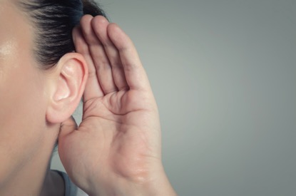

Deaf and Hard of Hearing
Get the person’s attention before speaking.
Speak in normal tones.
If someone is using an interpreter:
  Look at and speak directly to the person who is deaf or hard of hearing, and have the conversation with them.
  Don’t say to the interpreter, “Tell them…”

Slide 49

Speech and Communication Disabilities
Don’t guess what the person said.
If you’re not sure, repeat back what you think they were saying.
Don’t hesitate to ask the person to repeat themselves.
Don’t try to finish people’s sentences or speak for them.
If the person is using a communication device, be patient while the person composes their conversation and response.
If you’re having trouble understanding the person, ask if they can write down or type what they are saying.

Slide 50
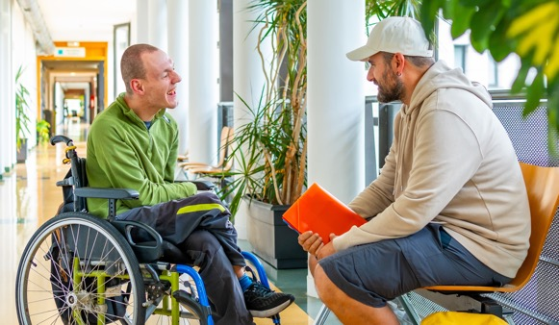

Additional General Etiquette Tips
Don’t touch a person’s assistive or mobility device.
If a person has an aid or someone assisting them, speak directly to the person with a disability.
When talking to someone, try to get to their level, and hold conversation in a location where you can engage comfortably, and reduces distance between the two of you.
Service animals are working. Do not pet or play with them.

Slide 51

Language Considerations

Slide 52
Language Guide
Inappropriate Term | Appropriate Term
Handicap | Disabled, Person with a Disability
Retarded | Intellectual Disability, Cognitive Disability,
Wheelchair bound | Uses a wheelchair, Wheelchair user
Suffers from… | Has…
Brain damaged | Head injury
Crazy, psycho | Person with mental health issues, mental illness
Deaf-Mute, Deaf & Dumb | Deaf, Hard of Hearing
Cripple | Physical disability

Slide 53


Language:
People First vs.
Identity First

Slide 54
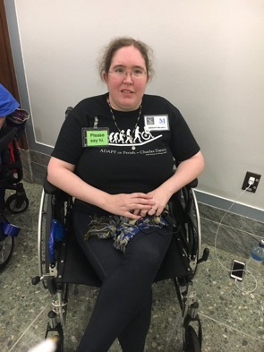
“I have a number of physical disabilities, and I have no preference.
What matters to me is that the surrounding conversation indicates that whoever I’m talking with sees me as a person and respects me fully as such.”
Irina Greenman

Slide 55
The Best Term to Use to Describe Someone With a Disability?
Their Name

Slide 56


Slide 57
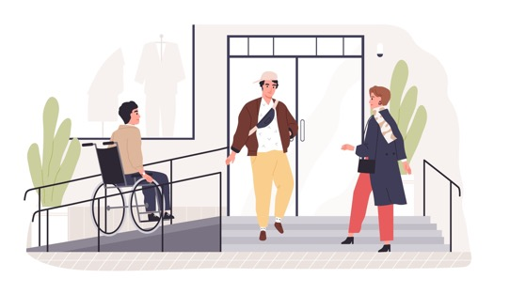


Creating a culture of welcoming people with disabilities
Anticipate needs.
Everyone asked about support and accommodation needs.
Disability-specific information to everyone.
Maintain and respect confidentiality.
Address both in-person and online interactions.
Integrate consideration of disability issues into overall discussions of policy, planning, and activities.
Engage disability community in process of evaluation and enhancing accessibility.
Process never ends.

Slide 58
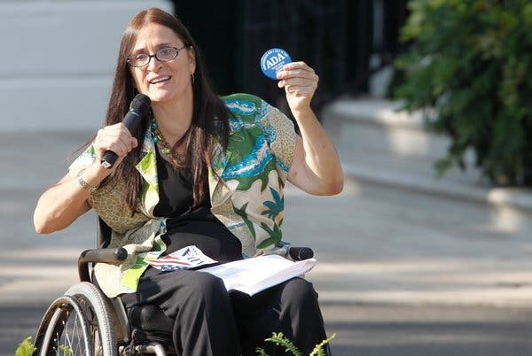
“The things we've been advocating are not just for a marginal group of people; they're for the
society as a whole.
Disability affects all of us.
It's time that we normalize and accept it rather than perceive it to be at the margins of our society."
- Marca Bristo

Slide 59


Thank you

